Slide 1
AVL TREE

Slide 2
Balanced Binary Tree
The disadvantage of a binary search tree is that its height can be as large as N-1
This means that the time needed to perform insertion and deletion and many other operations can be O(N) in the worst case
We want a tree with small height
A binary tree with N node has height at least
θ(log N)
Thus, our goal is to keep the height of a binary search tree O(log N)
Such trees are called balanced binary search trees.
Examples are AVL tree, red-black tree.

Slide 3
Binary search Tree- Best Time?
What is the best case tree?
What is the worst case tree?
So, best case running time of BST operations is O(log N)
Worst case running time is O(N)
What happens when you Insert elements in ascending order?
Insert: 2, 4, 6, 8, 10, 12 into an empty BST
Problem: Lack of “balance”:
Compare depths of left and right subtree
Unbalanced degenerate tree

Slide 4
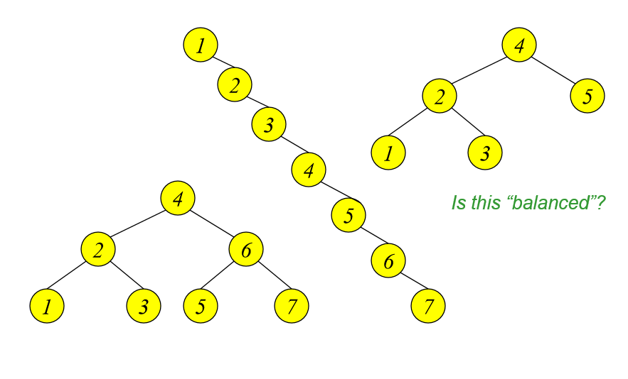
Balanced & Unbalanced BST

Slide 5
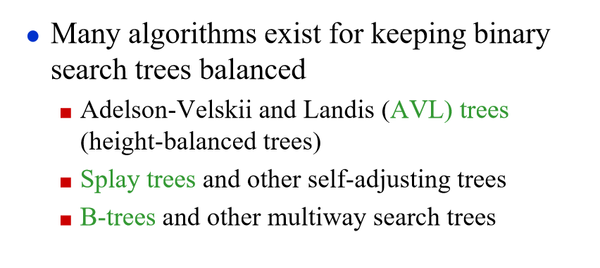
Balancing Binary Search Trees

Slide 6
Why AVL Tree?
Most of the BST operations (e.g., search, max, min, insert, delete.. etc.) take O(h) time where h is the height of the BST.
The cost of these operations may become O(n) for a skewed Binary Search tree.
If we make sure that height of the tree remains O(Log n) after every insertion and deletion, then we can guarantee an upper bound of O(Log n) for all these operations.
The height of an AVL tree is always O(Log n) where n is the number of nodes in the tree

Slide 7
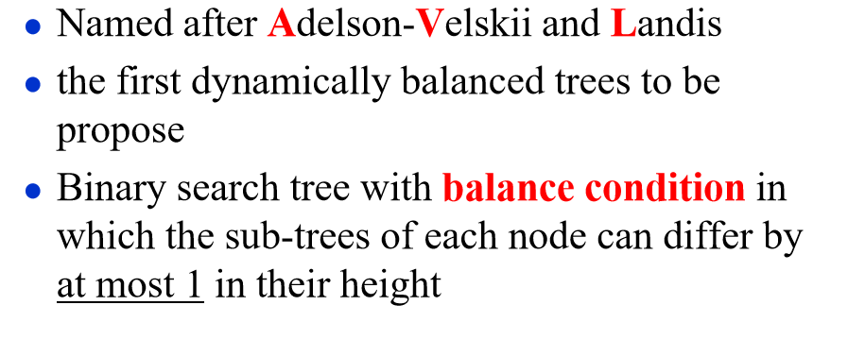
AVL Tree
https://www.geeksforgeeks.org/introduction-to-avl-tree/

Slide 8
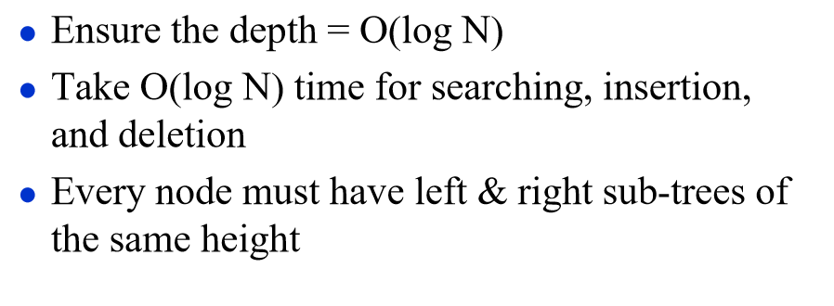
Definition of Balanced Tree

Slide 9
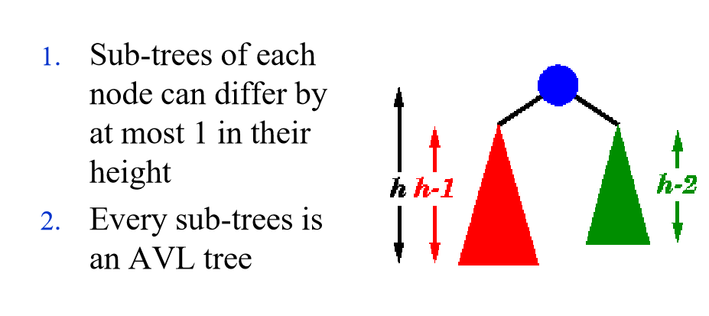
Properties of AVL Tree

Slide 10
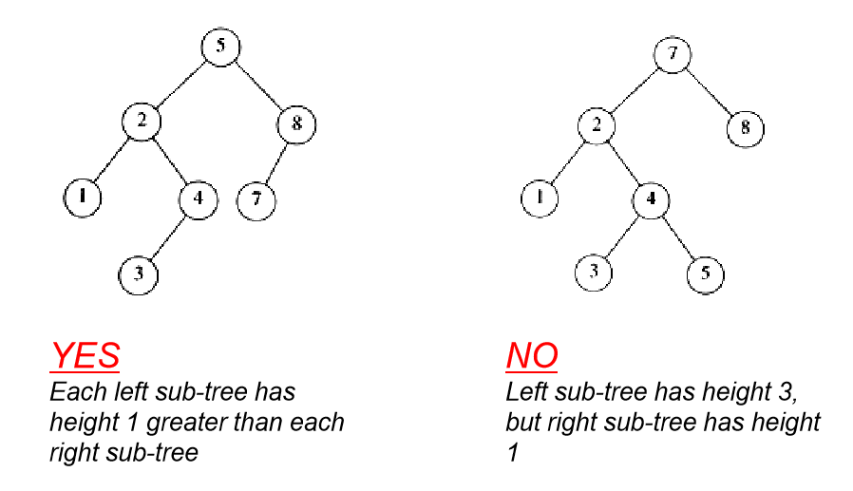
AVL Tree?

Slide 11
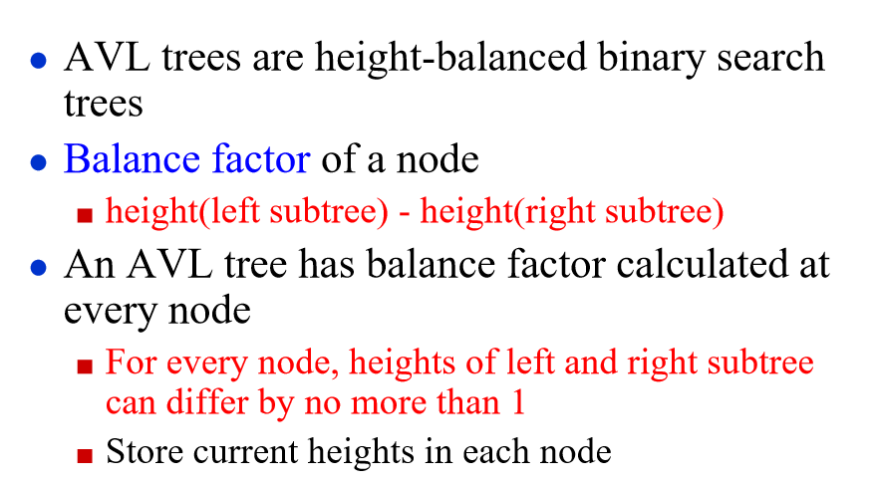

Slide 12
Rotations In AVL Tree
To balance itself, an AVL tree may perform the following four kinds of rotations −
Left rotation
Right rotation
Left-Right rotation
Right-Left rotation
The first two rotations are single rotations and the next two rotations are double rotations. To have an unbalanced tree, we at least need a tree of height 2.

Slide 13
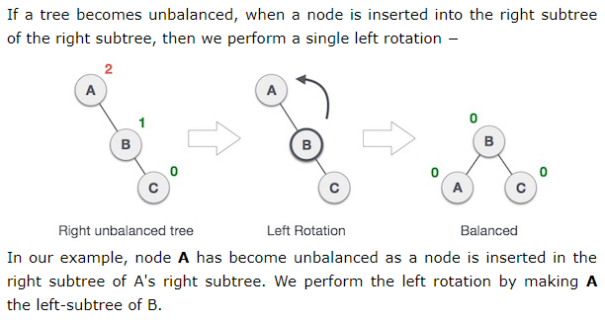
Left Rotation

Slide 14
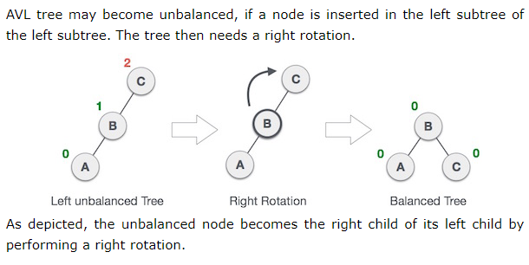
Right Rotation

Slide 15
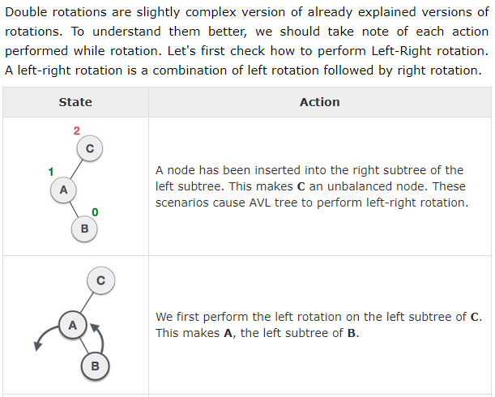
Left-Right Rotation

Slide 16
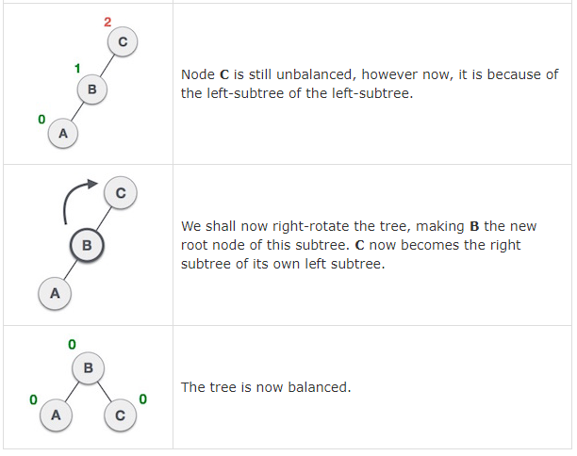

Slide 17
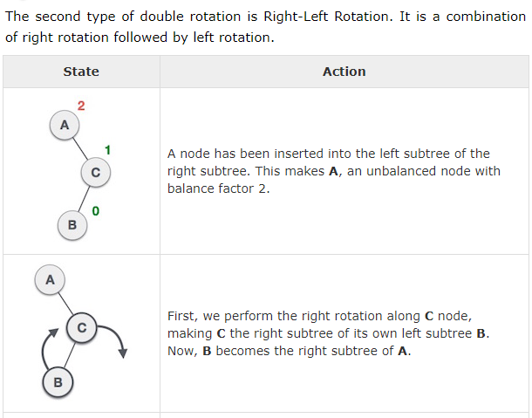
Right-Left Rotation

Slide 18
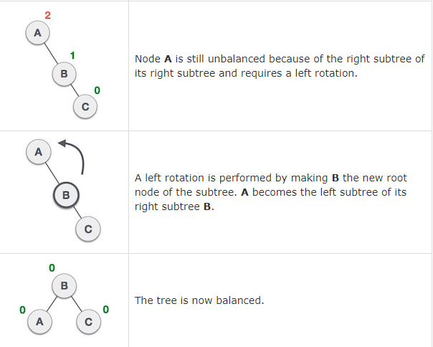

Slide 19
AVL Tree Insertion
To make sure that the given tree remains AVL after every insertion, we must augment the standard BST insert operation to perform some re-balancing.
Insertion will be take place same as BST
After every insertion we have to balance the tree

Slide 20
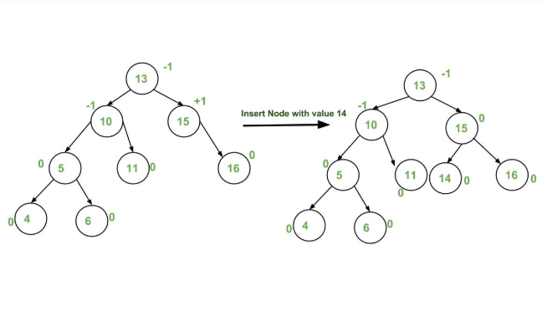
Example

Slide 21
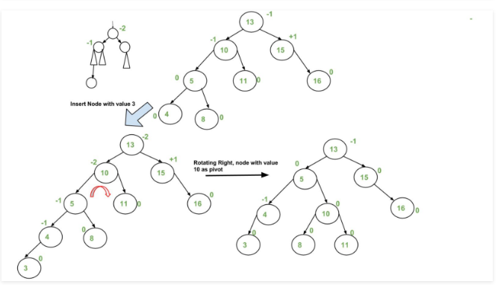
Notes:
Above LL exist, LR exist but
Consider that side where height is more

Slide 22
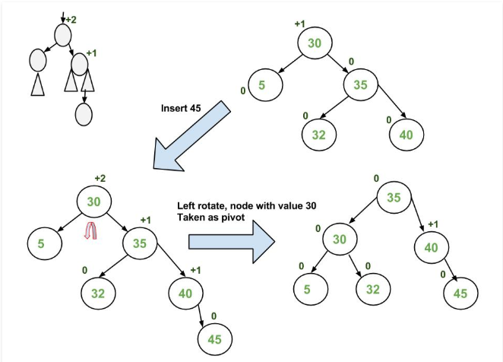

Slide 23
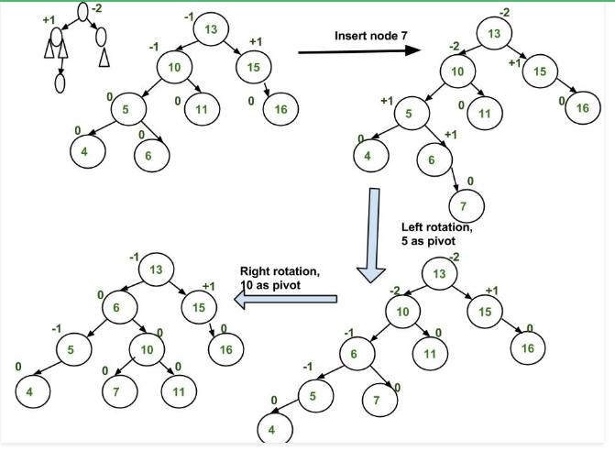

Slide 24
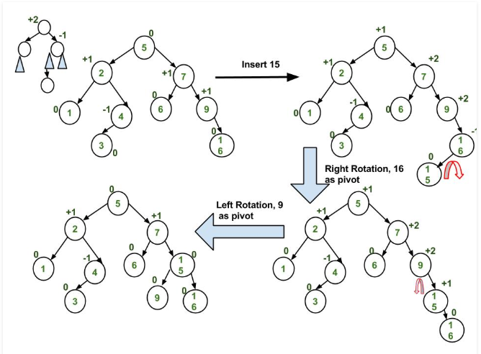
Notes:
Consider that subtree whose height is larger

Slide 25
AVL Tree Deletion
Deletion will be same as BST
After each deletion we have to re-balance the tree with the help of rotations

Slide 26
AVL Tree Example:
Insert 14, 17, 11, 7, 53, 4, 13 into an empty AVL tree
14
11
17
7
53
4

Slide 27
AVL Tree Example:
Insert 14, 17, 11, 7, 53, 4, 13 into an empty AVL tree
14
7
17
4
11
53
13

Slide 28
AVL Tree Example:
Now insert 12
14
7
17
4
11
53
13
12

Slide 29
AVL Tree Example:
Now insert 12
14
7
17
4
11
53
12
13

Slide 30
AVL Tree Example:
Now the AVL tree is balanced.
14
7
17
4
12
53
11
13

Slide 31
AVL Tree Example:
Now insert 8
14
7
17
4
12
53
11
13
8

Slide 32
AVL Tree Example:
Now insert 8
14
7
17
4
11
53
8
12
13

Slide 33
AVL Tree Example:
Now the AVL tree is balanced.
14
11
17
7
12
53
4
8
13

Slide 34
AVL Tree Example:
Now remove 53
14
11
17
7
12
53
4
8
13

Slide 35
AVL Tree Example:
Now remove 53, unbalanced
14
11
17
7
12
4
8
13
Notes:
Here 14, 11, 7 will be considered because at left subtree number of nodes are large

Slide 36
AVL Tree Example:
Balanced! Remove 11
11
7
14
4
8
12
17
13

Slide 37
AVL Tree Example:
Remove 11, replace it with the largest in its left branch
8
7
14
4
12
17
13

Slide 38
AVL Tree Example:
Remove 8, unbalanced
7
4
14
12
17
13

Slide 39
AVL Tree Example:
Remove 8, unbalanced
7
4
12
14
13
17

Slide 40
AVL Tree Example:
Balanced!!
12
7
14
4
13
17

Slide 41
In Class Exercises
Build an AVL tree with the following values:
15, 20, 24, 10, 13, 7, 30, 36, 25

Slide 42
15, 20, 24, 10, 13, 7, 30, 36, 25
20
15
15
24
20
10
24
13
20
20
13
24
15
24
10
15
13
10

Slide 43
15, 20, 24, 10, 13, 7, 30, 36, 25
20
13
13
24
10
20
10
15
7
15
24
7
30
13
36
10
20
7
15
30
24
36

Slide 44
15, 20, 24, 10, 13, 7, 30, 36, 25
13
13
10
20
10
20
7
15
30
7
15
24
24
36
30
25
13
25
36
10
24
7
20
30
15
25
36

Slide 45
Remove 24 and 20 from the AVL tree.
13
13
10
24
10
20
7
20
30
7
15
30
15
25
36
25
36
13
13
10
30
10
15
7
15
36
7
30
25
25
36

Slide 46
Search In AVL Tree
Searching in AVL tree is same as BST tree
If an element is greater than root node then it will be present at the right of the node otherwise it will be present at the left of the node.

Slide 47
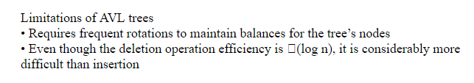
Limitations of AVL Tree

Slide 48
Advantages and Disadvantages of AVL Tree
Advantages of AVL Tree:
AVL trees can self-balance themselves.
It is surely not skewed.
It provides faster lookups than Red-Black Trees
Better searching time complexity compared to other trees like binary tree.
Height cannot exceed log(N), where, N is the total number of nodes in the tree.
Disadvantages of AVL Tree:
It is difficult to implement.
It has high constant factors for some of the operations.
Less used compared to Red-Black trees.
Due to its rather strict balance, AVL trees provide complicated insertion and removal operations as more rotations are performed.
Take more processing for balancing.

Slide 49
Applications of AVL tree
It is used to index huge records in a database and also to efficiently search in that.
Database applications, where insertions and deletions are less common but frequent data lookups are necessary
Software that needs optimized search.

Slide 50
Properties of AVL Tree
Property 1: The most number of nodes an AVL tree of height H might have
= 2^{H+1} - 1
Maximum possible number of nodes in AVL tree of height-3.
Ans: 15
Property 2: A recursive relation determines the minimum number of nodes in an AVL Tree of height H.
N(H) = N(H-1) + N(H-2) + 1
Base conditions for this recursive relation are-
N(0) = 1, N(1) = 2

Slide 51
Property 3: The AVL Tree's smallest feasible height with N nodes
= [log N]
Minimum possible height of AVL Tree using 8 nodes
= [log 8] =3
Property 4: Using recursive relation, the maximum height of an AVL tree with N nodes is computed.
N(H) = N(H-1) + N(H-2) + 1
Base conditions for this recursive relation are-
N(0) = 1
N(1) = 2

Slide 52
Key Points
If there are n nodes in AVL tree, minimum height of AVL tree is floor(log₂ (n+1)).
If there are n nodes in AVL tree, maximum height can't exceed 1.44*log₂n.
Proof of height
https://courses.cs.washington.edu/courses/cse373/11au/lectures/AVL-proof-and-code.pdf

Slide 53
Practice questions
https://www.geeksforgeeks.org/practice-questions-height-balancedavl-tree/
https://www.geeksforgeeks.org/gate-gate-cs-2009-question-37/
https://practicepaper.in/gate-cse/avl-tree

Slide 54
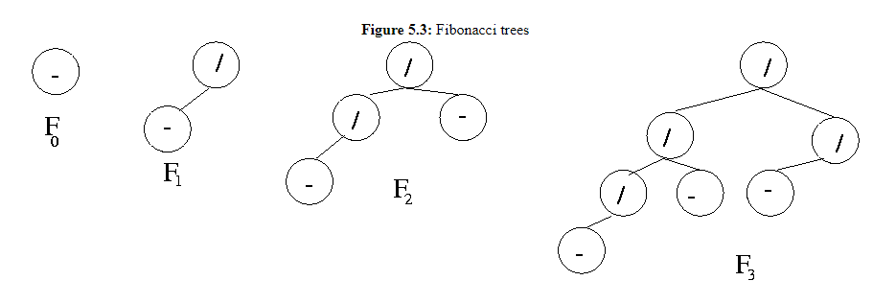
Height of AVL Tree
A Fibonacci tree of order n has the Fibonacci trees of orders n − 1 and n − 2 as left and right subtrees.

Slide 55
Problem 1: Find the bare minimum of nodes needed to build an AVL tree with height = 3.
Ans: 7

Slide 56
What is the maximum height of any AVL-tree with 7 nodes? Assume that the height of a tree with a single node is 0.
Ans: 3
Notes:
Ans is 3

